Slide 1
Data Mining
Practical Machine Learning Tools and Techniques
Slides for Chapter 3, Output: knowledge representation
of Data Mining by I. H. Witten, E. Frank, M. A. Hall and C. J. Pal

Slide 2
Output: Knowledge representation
Tables
Linear models
Trees
Rules
Classification rules
Association rules
Rules with exceptions
More expressive rules
Instance-based representation
Clusters

Slide 3
Output: representing structural patterns
Many different ways of representing patterns
Decision trees, rules, instance-based, …
Also called “knowledge” representation
Representation determines inference method
Understanding the output is the key to understanding the underlying learning methods
Different types of output for different learning problems (e.g., classification, regression, …)

Slide 4
Decision tables
Simplest way of representing output:
Use the format that is used for representing the input!
Decision table for the weather problem:
Main problem: selecting the right attributes
Outlook
Humidity
Play
Sunny
High
No
Sunny
Normal
Yes
Overcast
High
Yes
Overcast
Normal
Yes
Rainy
High
No
Rainy
Normal
No

Slide 5
Linear models
Another simple representation
Traditionally primarily used for regression:
Inputs (attribute values) and output are all numeric
Output is the sum of the weighted input attribute values
The trick is to find good values for the weights
There are different ways of doing this, which we will consider later; the most famous one is to minimize the squared error

Slide 6
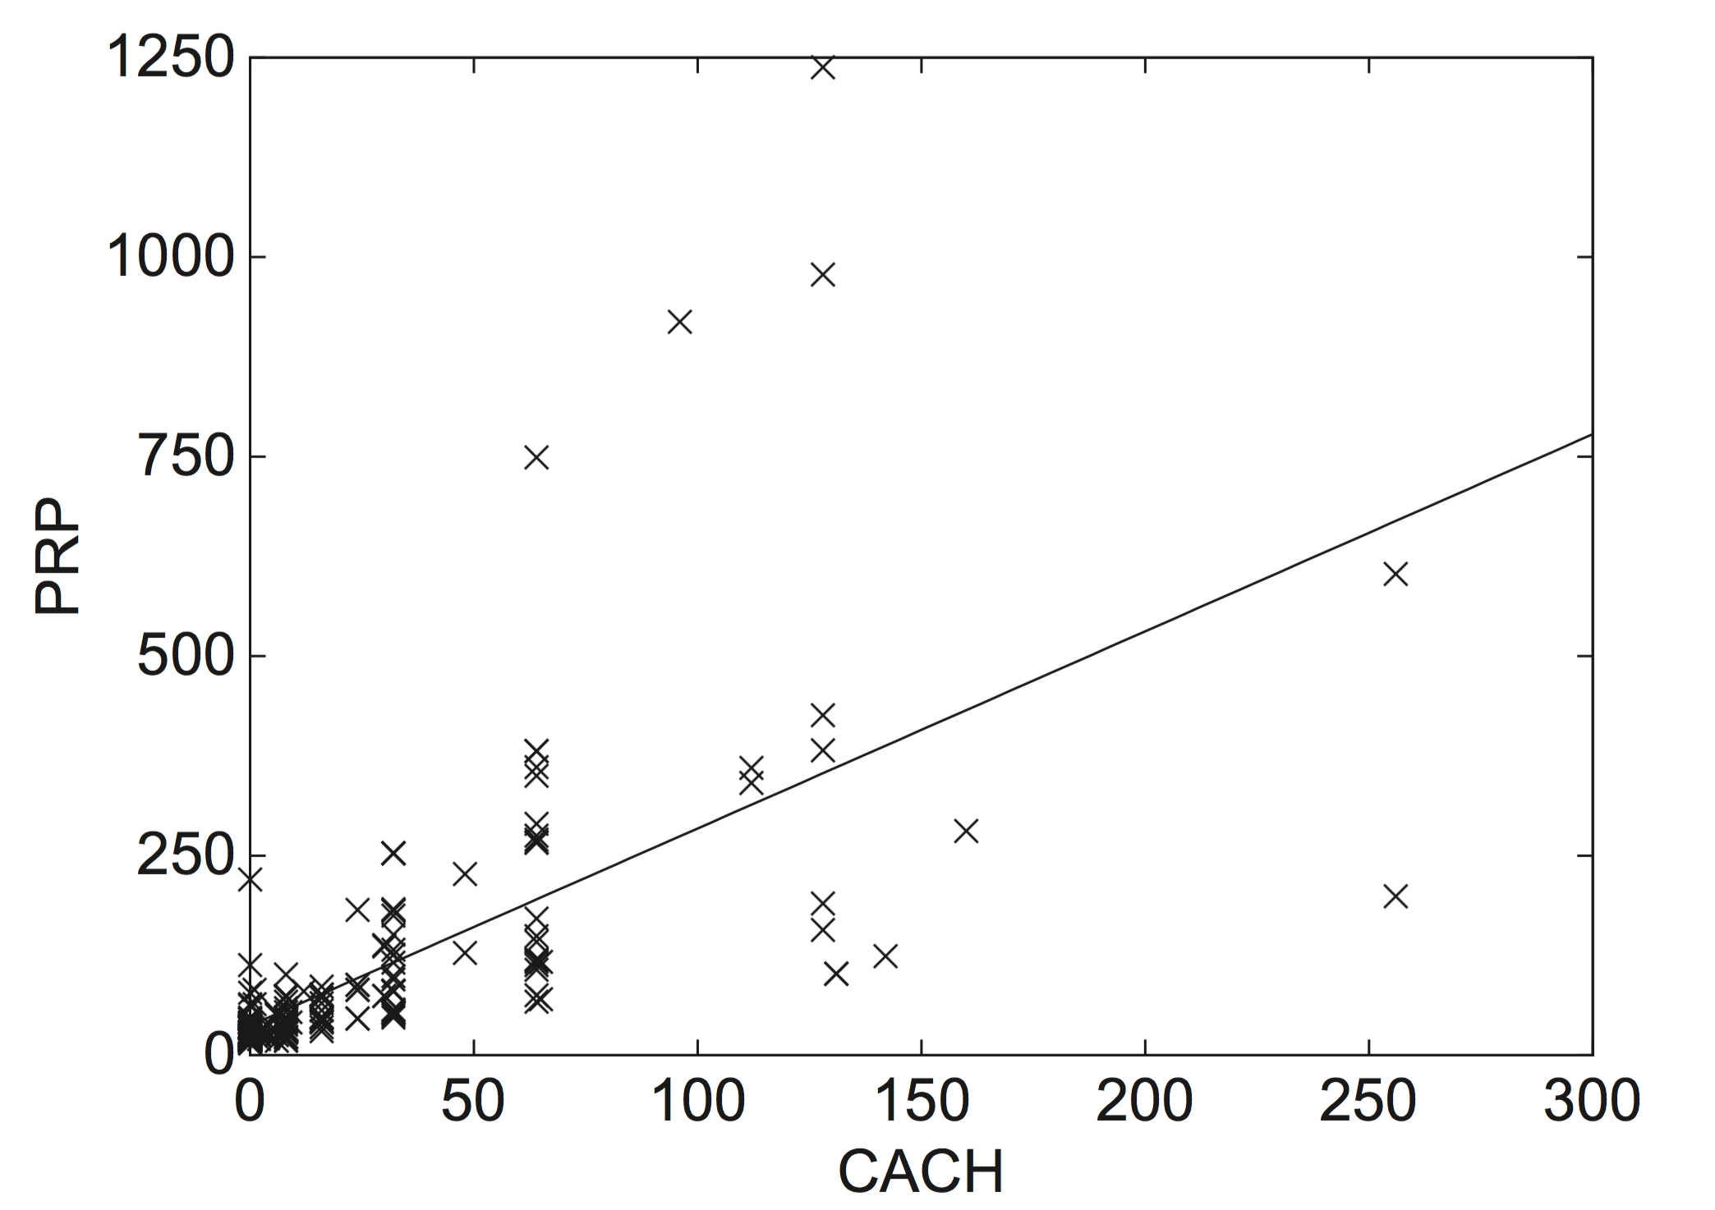
A linear regression function for the CPU performance data
PRP = 37.06 + 2.47CACH

Slide 7
Linear models for classification
Binary classification
Line separates the two classes
Decision boundary - defines where the decision changes from one class value to the other
Prediction is made by plugging in observed values of the attributes into the expression
Predict one class if output ≥ 0, and the other class if output < 0
Boundary becomes a high-dimensional plane (hyperplane) when there are multiple attributes

Slide 8
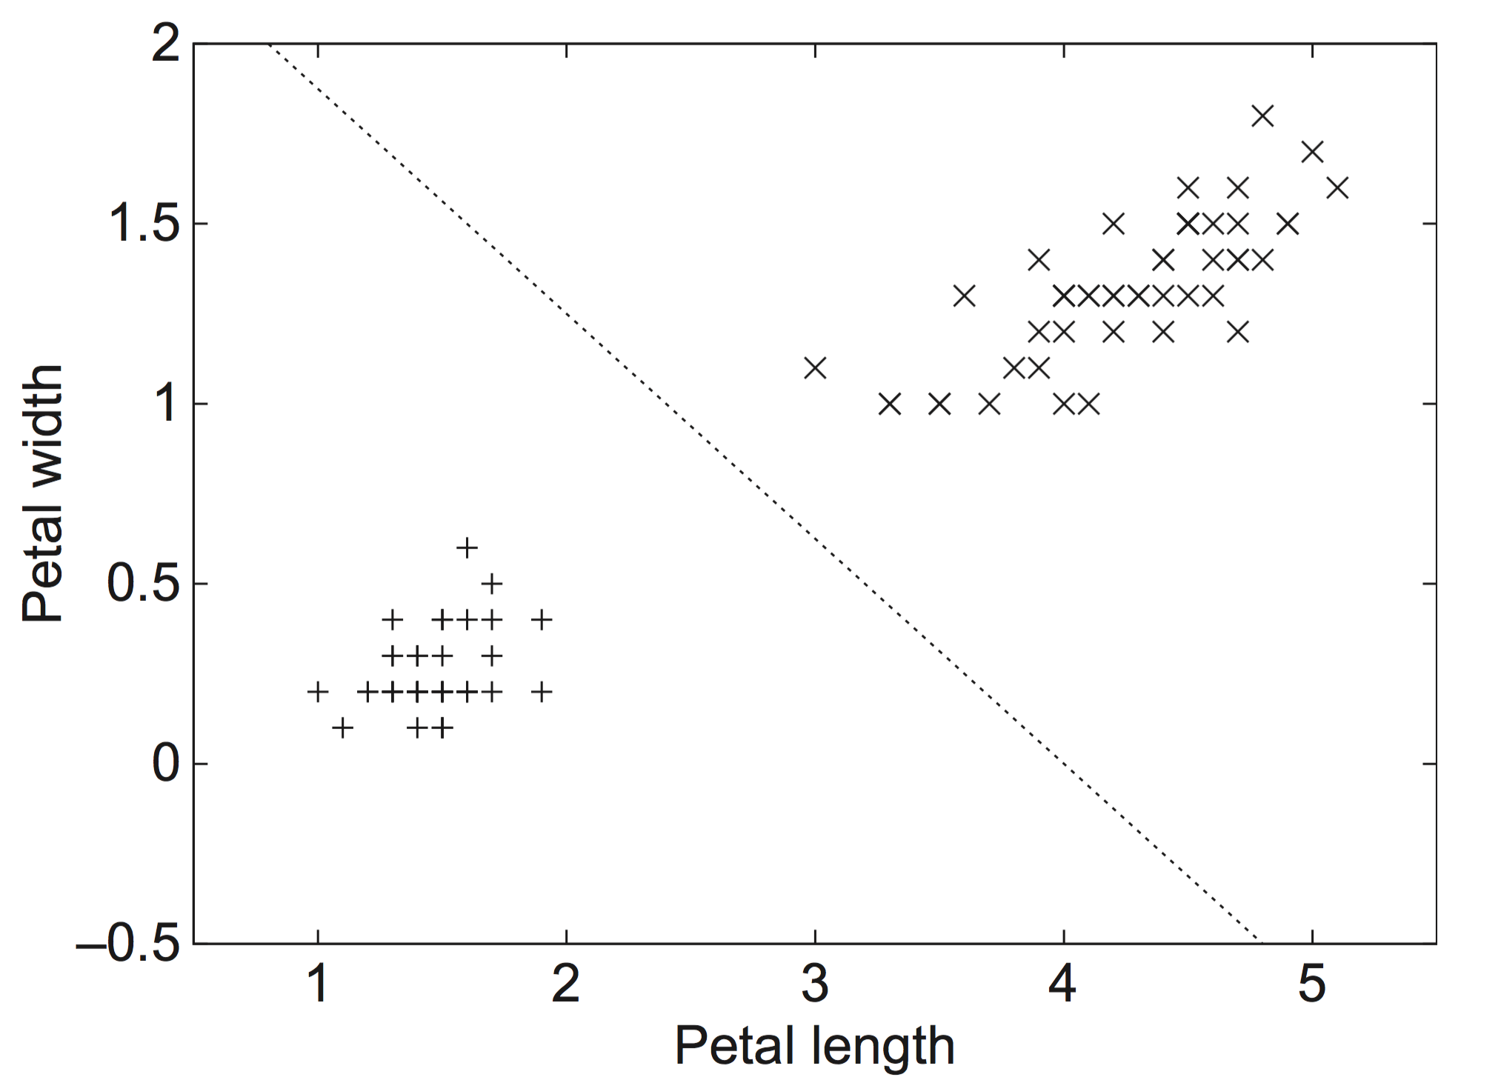
Separating setosas from versicolors
2.0 – 0.5PETAL-LENGTH – 0.8PETAL-WIDTH = 0

Slide 9
Decision trees
“Divide-and-conquer” approach produces tree
Nodes involve testing a particular attribute
Usually, attribute value is compared to constant
Other possibilities:
Comparing values of two attributes
Using a function of one or more attributes
Leaves assign classification, set of classifications, or probability distribution to instances
Unknown instance is routed down the tree

Slide 10
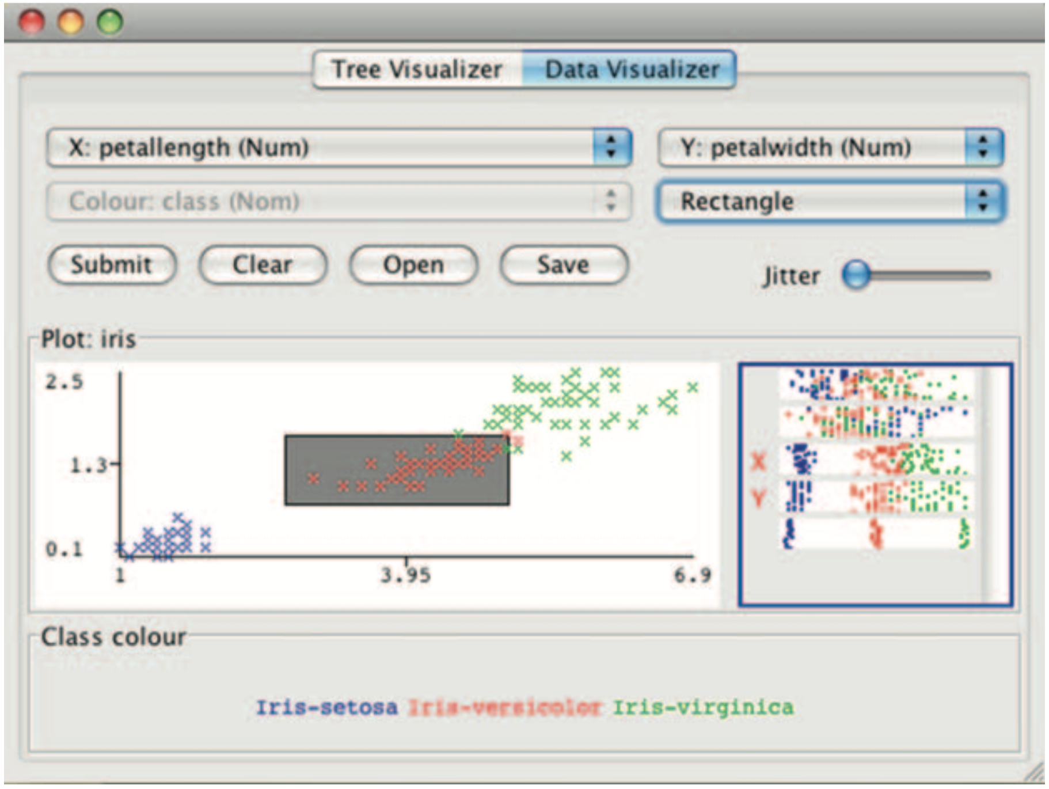
Interactive tree construction I

Slide 11
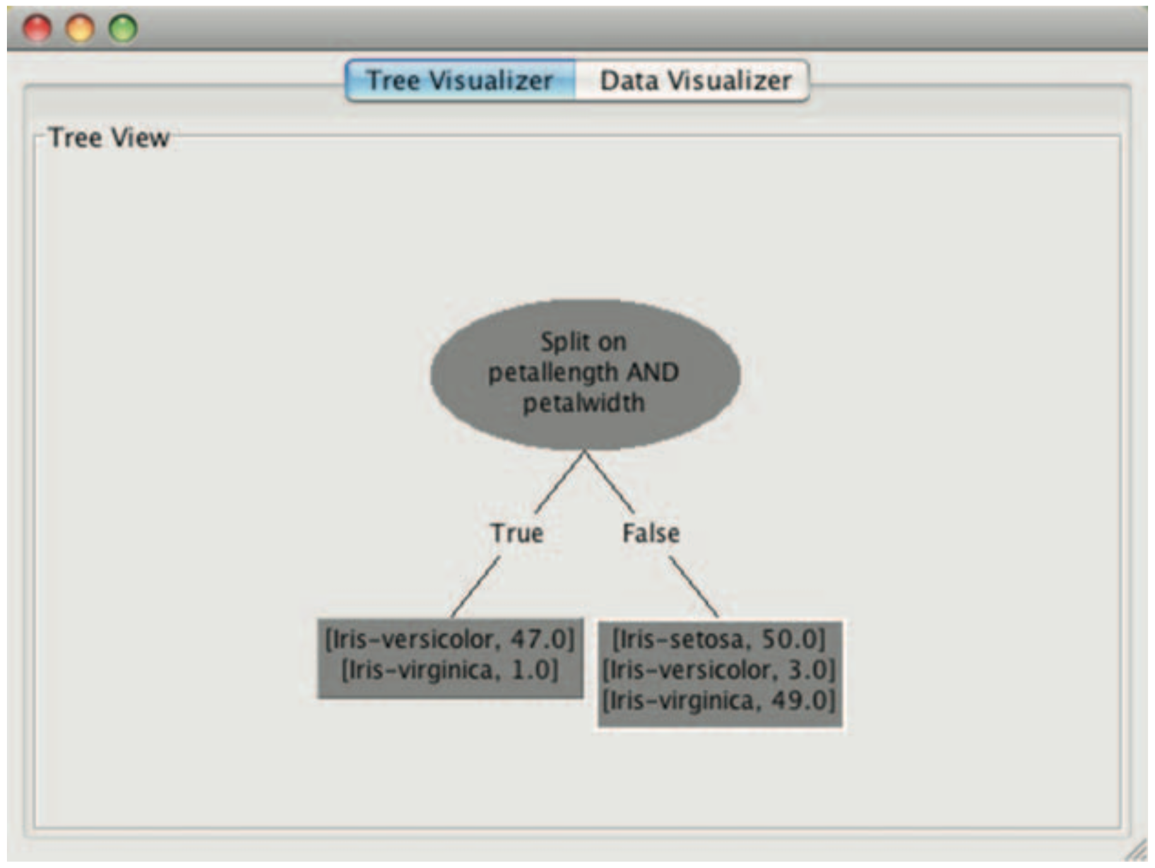
Interactive tree construction II

Slide 12
Nominal and numeric attributes in trees
Nominal: number of children usually equal to number values ⇒ attribute won’t get tested more than once
Other possibility: division into two subsets
Numeric: test whether value is greater or less than constant ⇒ attribute may get tested several times
Other possibility: three-way split (or multi-way split)
Integer: less than, equal to, greater than
Real: below, within, above

Slide 13
Missing values
Does absence of value have some significance?
Yes ⇒ “missing” is a separate value
No ⇒ “missing” must be treated in a special way
Solution A: assign instance to most popular branch
Solution B: split instance into pieces
Pieces receive weight according to fraction of training instances that go down each branch
Classifications from leave nodes are combined using the weights that have percolated to them

Slide 14
Trees for numeric prediction
Regression: the process of computing an expression that predicts a numeric quantity
Regression tree: “decision tree” where each leaf predicts a numeric quantity
Predicted value is average value of training instances that reach the leaf
Model tree: “regression tree” with linear regression models at the leaf nodes
Linear patches approximate continuous function

Slide 15
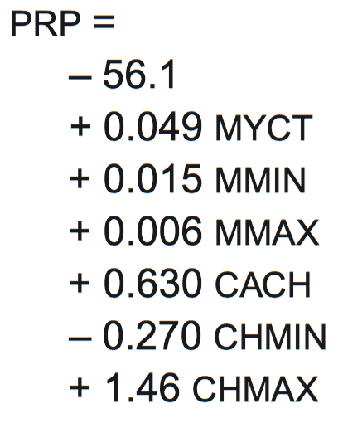
Linear regression for the CPU data
PRP =
- 56.1
+ 0.049 MYCT
+ 0.015 MMIN
+ 0.006 MMAX
+ 0.630 CACH
- 0.270 CHMIN
+ 1.46 CHMAX

Slide 16
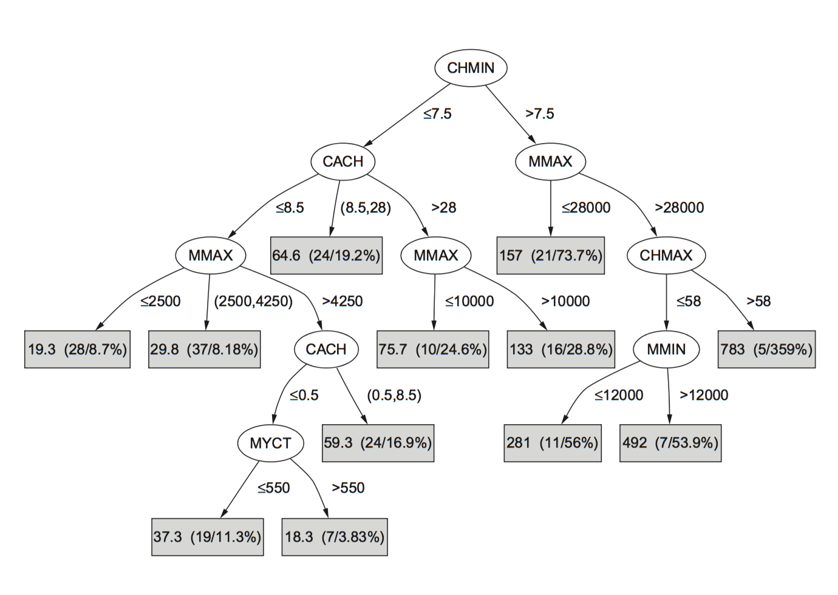
Regression tree for the CPU data

Slide 17
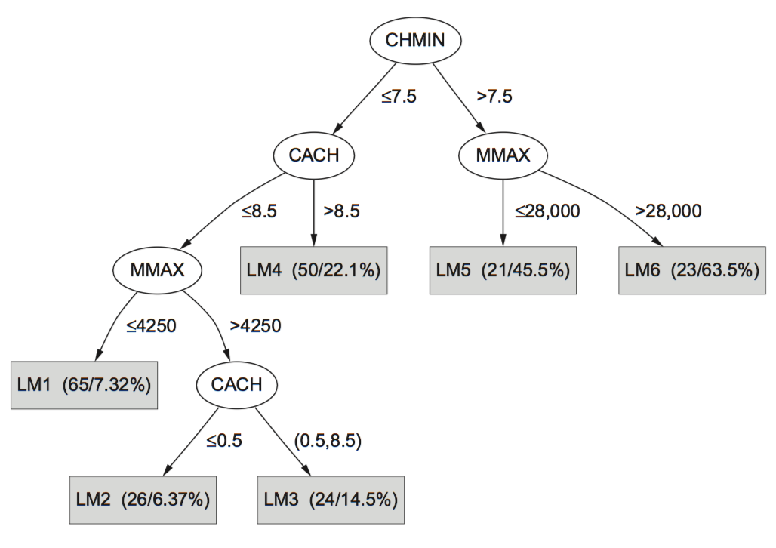
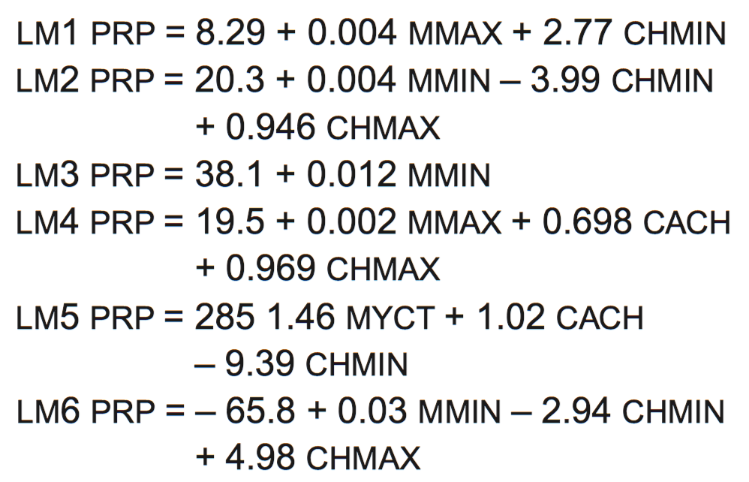
Model tree for the CPU data

Slide 18
Classification rules
Popular alternative to decision trees
Antecedent (pre-condition): a series of tests (just like the tests at the nodes of a decision tree)
Tests are usually logically ANDed together (but may also be general logical expressions)
Consequent (conclusion): classes, set of classes, or probability distribution assigned by rule
Individual rules are often logically ORed together
Conflicts arise if different conclusions apply

Slide 19
From trees to rules
Easy: converting a tree into a set of rules
One rule for each leaf:
Antecedent contains a condition for every node on the path from the root to the leaf
Consequent is class assigned by the leaf
Produces rules that are unambiguous
Doesn’t matter in which order they are executed
But: resulting rules are unnecessarily complex
Pruning to remove redundant tests/rules

Slide 20
From rules to trees
More difficult: transforming a rule set into a tree
Tree cannot easily express disjunction between rules
Example: rules which test different attributes
Symmetry needs to be broken
Corresponding tree contains identical subtrees (⇒ “replicated subtree problem”)
If a and b then x
If c and d then x

Slide 21
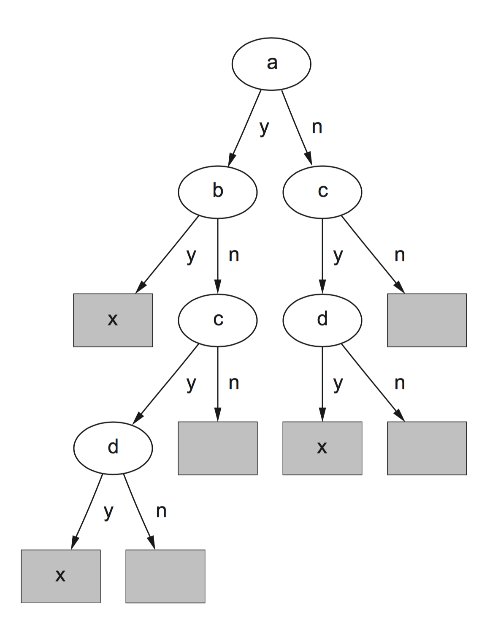
A tree for a simple disjunction

Slide 22
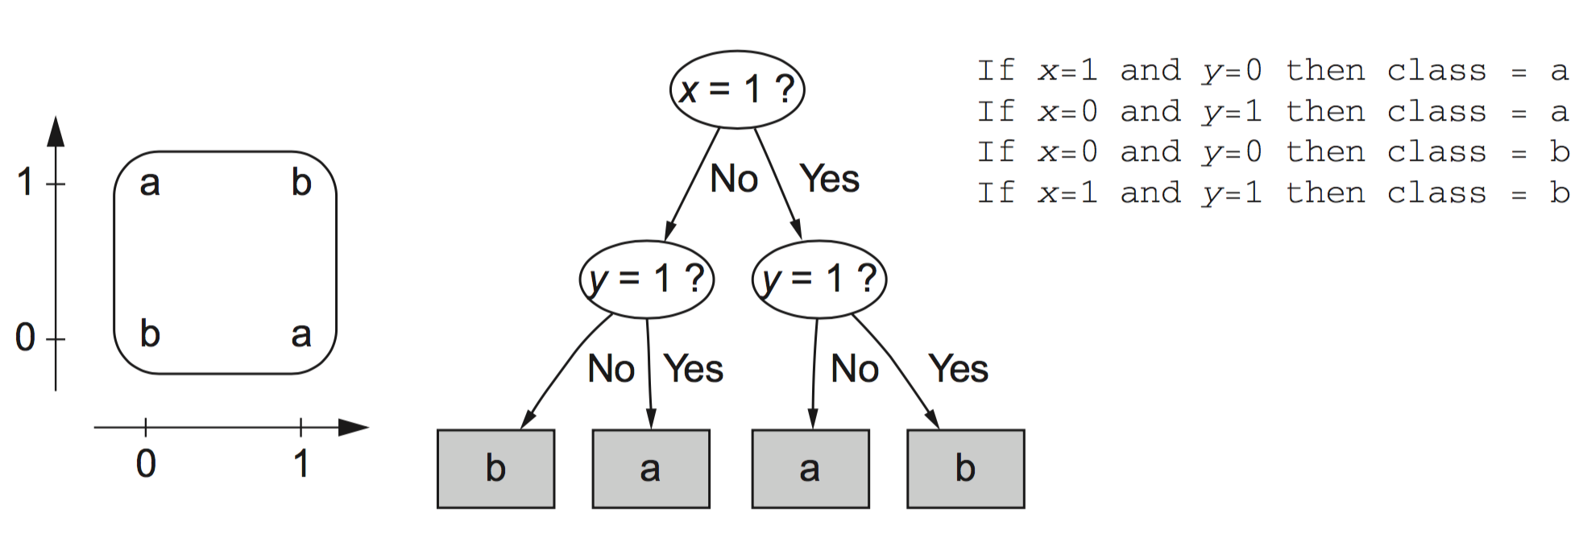
The exclusive-or problem

Slide 23
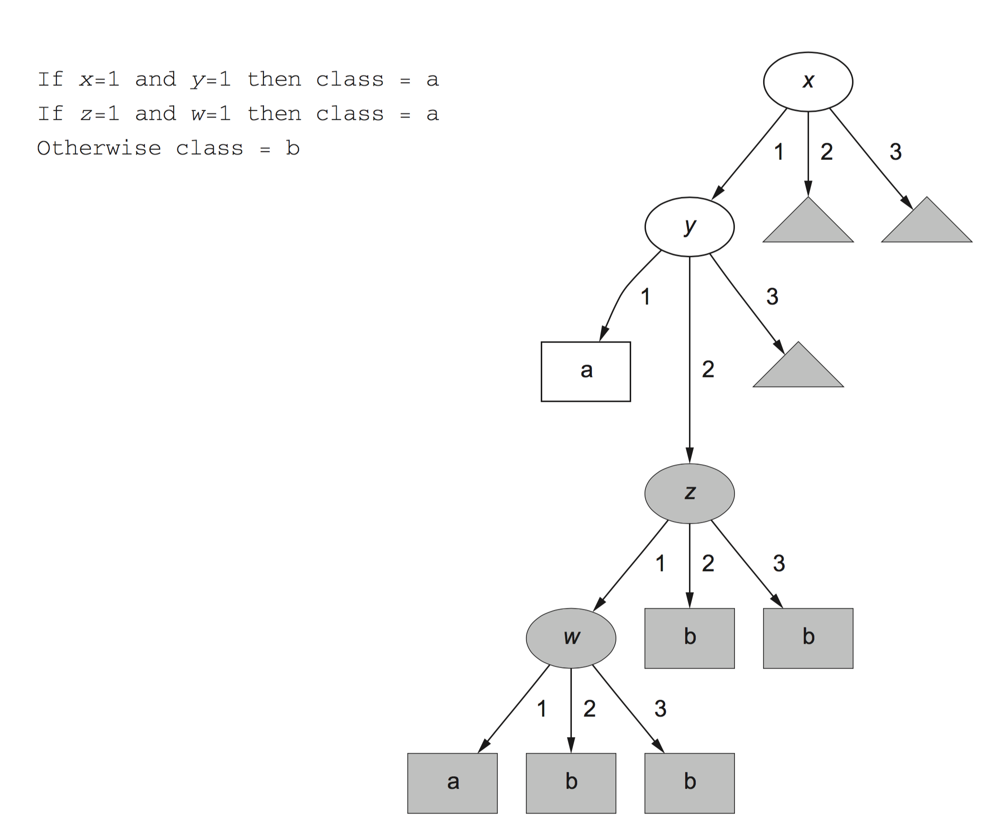
A tree with a replicated subtree

Slide 24
“Nuggets” of knowledge
Are rules independent pieces of knowledge? (It seems easy to add a rule to an existing rule base.)
Problem: ignores how rules are executed
Two ways of executing a rule set:
Ordered set of rules (“decision list”)
Order is important for interpretation
Unordered set of rules
Rules may overlap and lead to different conclusions for the same instance

Slide 25
Interpreting rules
What if two or more rules conflict?
Give no conclusion at all?
Go with rule that is most popular on training data?
…
What if no rule applies to a test instance?
Give no conclusion at all?
Go with class that is most frequent in training data?
…

Slide 26
Special case: Boolean class
Assumption: if instance does not belong to class “yes”, it belongs to class “no”
Trick: only learn rules for class “yes” and use default rule for “no”
Order of rules is not important. No conflicts!
Rule can be written in disjunctive normal form
If x = 1 and y = 1 then class = a
If z = 1 and w = 1 then class = a
Otherwise class = b

Slide 27
Association rules
Association rules…
… can predict any attribute and combinations of attributes
… are not intended to be used together as a set
Problem: immense number of possible associations
Output needs to be restricted to show only the most predictive associations ⇒ only those with high support and high confidence

Slide 28
Support and confidence of a rule
Support: number of instances predicted correctly
Confidence: number of correct predictions, as proportion of all instances that rule applies to
Example: 4 cool days with normal humidity
Support = 4, confidence = 100%
Normally: minimum support and confidence pre-specified (e.g. 58 rules with support ≥ 2 and confidence ≥ 95% for weather data)
If temperature = cool then humidity = normal

Slide 29
Interpreting association rules
Interpretation is not obvious:
is not the same as
It means that the following also holds:
If windy = false and play = no then outlook = sunny and humidity = high
If windy = false and play = no then outlook = sunny
If windy = false and play = no then humidity = high
If humidity = high and windy = false and play = no
then outlook = sunny

Slide 30
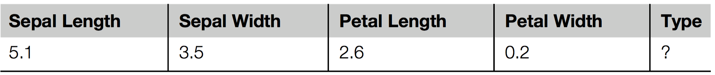
Rules with exceptions
Idea: allow rules to have exceptions
Example: rule for iris data
New instance:
Modified rule:
If petal-length ≥ 2.45 and petal-length < 4.45 then Iris-versicolor
If petal-length ≥ 2.45 and petal-length < 4.45 then Iris-versicolor
EXCEPT if petal-width < 1.0 then Iris-setosa

Slide 31
A more complex example
Exceptions to exceptions to exceptions …
default: Iris-setosa
except if petal-length ≥ 2.45 and petal-length < 5.355
and petal-width < 1.75
then Iris-versicolor
except if petal-length ≥ 4.95 and petal-width < 1.55
then Iris-virginica
else if sepal-length < 4.95 and sepal-width ≥ 2.45
then Iris-virginica
else if petal-length ≥ 3.35
then Iris-virginica
except if petal-length < 4.85 and sepal-length < 5.95
then Iris-versicolor

Slide 32
Advantages of using exceptions
Rules can be updated incrementally
Easy to incorporate new data
Easy to incorporate domain knowledge
People often think in terms of exceptions
Each conclusion can be considered just in the context of rules and exceptions that lead to it
Locality property is important for understanding large rule sets
“Normal” rule sets do not offer this advantage

Slide 33
More on exceptions
Default...except if...then...
is logically equivalent to
if...then...else
(where the “else” specifies what the “default” does)
But: exceptions offer a psychological advantage
Assumption: defaults and tests early on apply more widely than exceptions further down
Exceptions reflect special cases

Slide 34
Rules involving relations
So far: all rules involved comparing an attribute-value to a constant (e.g. temperature < 45)
These rules are called “propositional” because they have the same expressive power as propositional logic
What if problem involves relationships between examples (e.g. family tree problem from above)?
Can’t be expressed with propositional rules
More expressive representation required

Slide 35
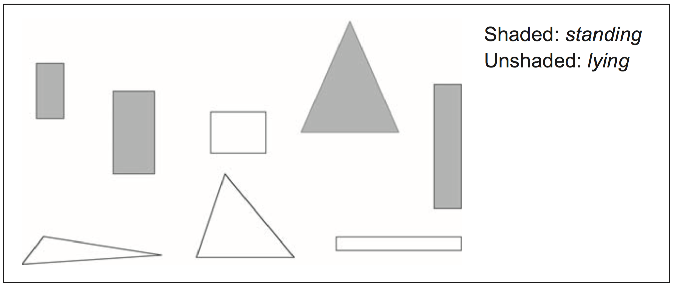
The shapes problem
Target concept: standing up
Shaded: standing Unshaded: lying

Slide 36
A propositional solution
Width
Height
Sides
Class
2
4
4
Standing
3
6
4
Standing
4
3
4
Lying
7
8
3
Standing
7
6
3
Lying
2
9
4
Standing
9
1
4
Lying
10
2
3
Lying
If width ≥ 3.5 and height < 7.0 then lying
If height ≥ 3.5 then standing

Slide 37
Using relations between attributes
Comparing attributes with each other enables rules like this:
This description generalizes better to new data
Standard relations: =, <, >
But: searching for relations between attributes can be costly
Simple solution: add extra attributes (e.g., a binary attribute “is width < height?”)
If width > height then lying
If height > width then standing

Slide 38
Rules with variables
Using variables and multiple relations:
The top of a tower of blocks is standing:
The whole tower is standing:
Recursive definition!
If height_and_width_of(x,h,w) and h > w then standing(x)
If height_and_width_of(x,h,w) and h > w and is_top_of(y,x) then standing(x)
If is_top_of(x,z) and height_and_width_of(z,h,w) and h > w and is_rest_of(x,y)and standing(y) then standing(x)
If empty(x) then standing(x)

Slide 39
Inductive logic programming
Recursive definition can be seen as logic program
Techniques for learning logic programs stem from the area of “inductive logic programming” (ILP)
But: recursive definitions are hard to learn
Also: few practical problems require recursion
Thus: many ILP techniques are restricted to non-recursive definitions to make learning easier

Slide 40
Instance-based representation
Simplest form of learning: rote learning
Training instances are searched for instance that most closely resembles new instance
The instances themselves represent the knowledge
Also called instance-based learning
Similarity function defines what’s “learned”
Instance-based learning is lazy learning
Methods: nearest-neighbor, k-nearest-neighbor, …

Slide 41
The distance function
Simplest case: one numeric attribute
Distance is the difference between the two attribute values involved (or a function thereof)
Several numeric attributes: normally, Euclidean distance is used and attributes are normalized
Nominal attributes: distance is set to 1 if values are different, 0 if they are equal
Are all attributes equally important?
Weighting the attributes might be necessary

Slide 42
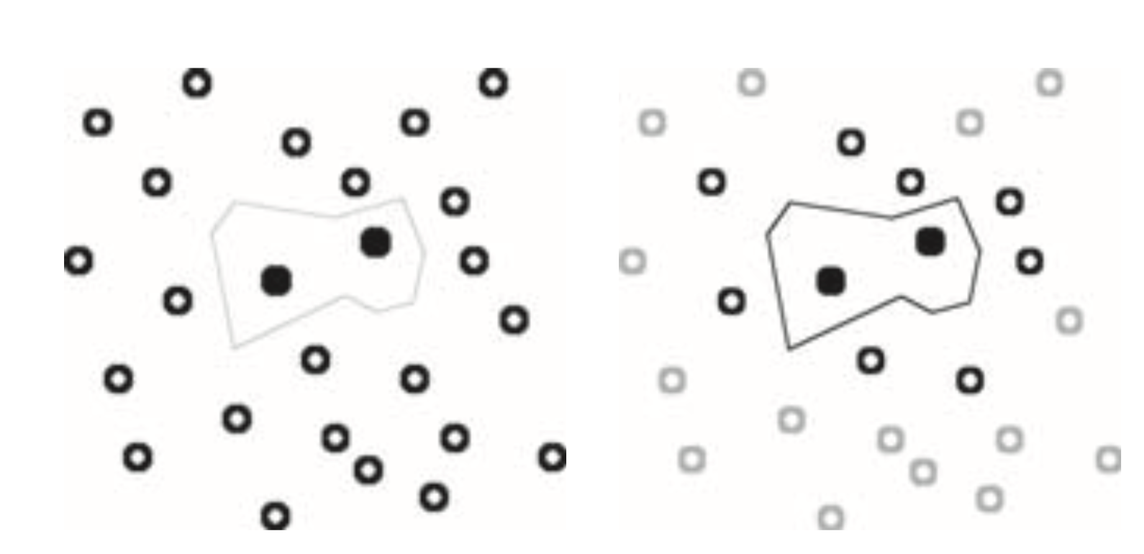
Learning prototypes
Only those instances involved in a decision need to be stored
Noisy instances should be filtered out
Idea: only use prototypical examples

Slide 43
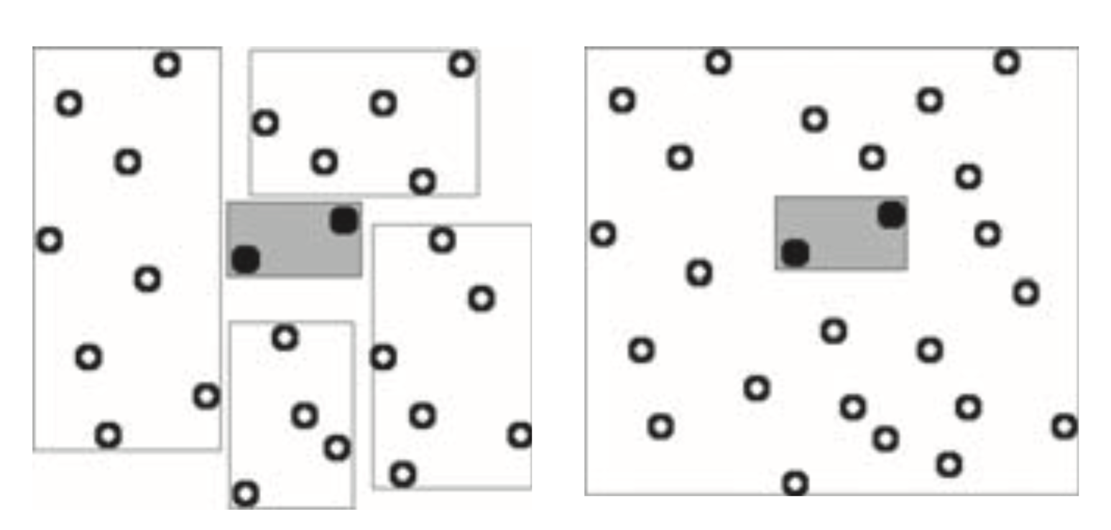
Rectangular generalizations
Nearest-neighbor rule is used outside rectangles
Rectangles are rules! (But they can be more conservative than “normal” rules.)
Nested rectangles are rules with exceptions

Slide 44
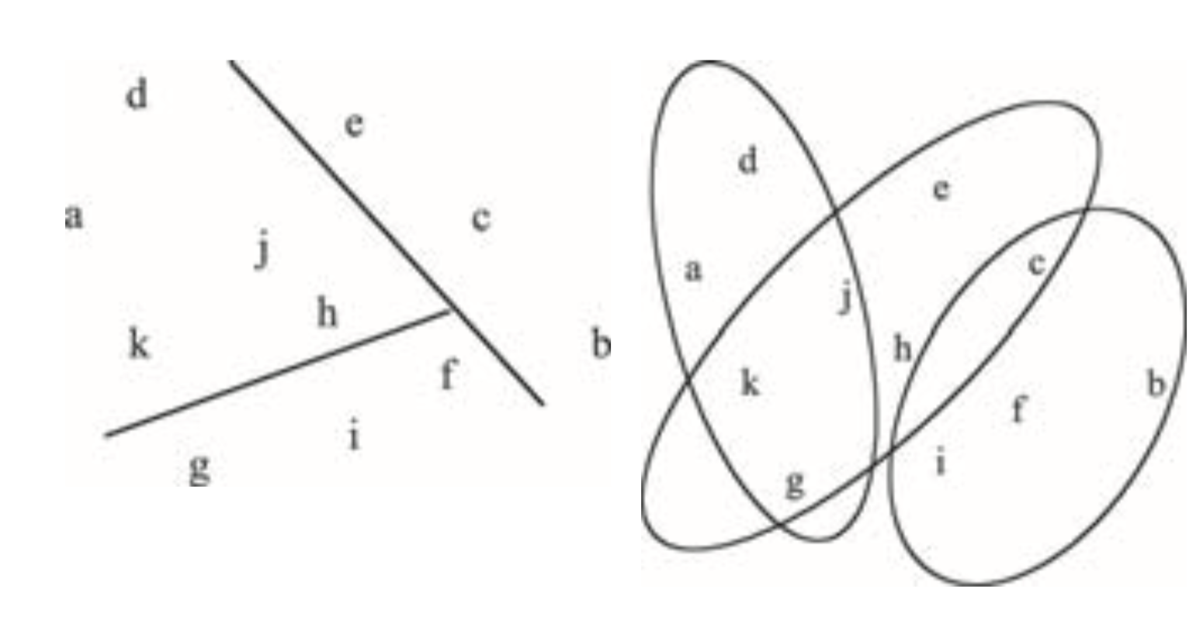
Representing clusters I
Simple 2-D representation
Venn diagram

Slide 45
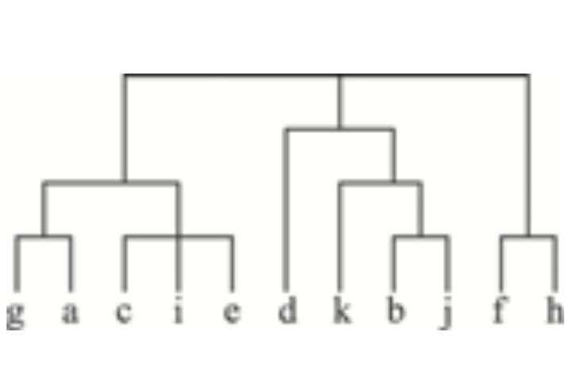
Representing clusters II
Probabilistic assignment
Dendrogram
1 2 3
a 0.4 0.1 0.5
b 0.1 0.8 0.1
c 0.3 0.3 0.4
d 0.1 0.1 0.8
e 0.4 0.2 0.4
f 0.1 0.4 0.5
g 0.7 0.2 0.1
h 0.5 0.4 0.1
…
NB: dendron is the Greek word for tree

